Slide 1
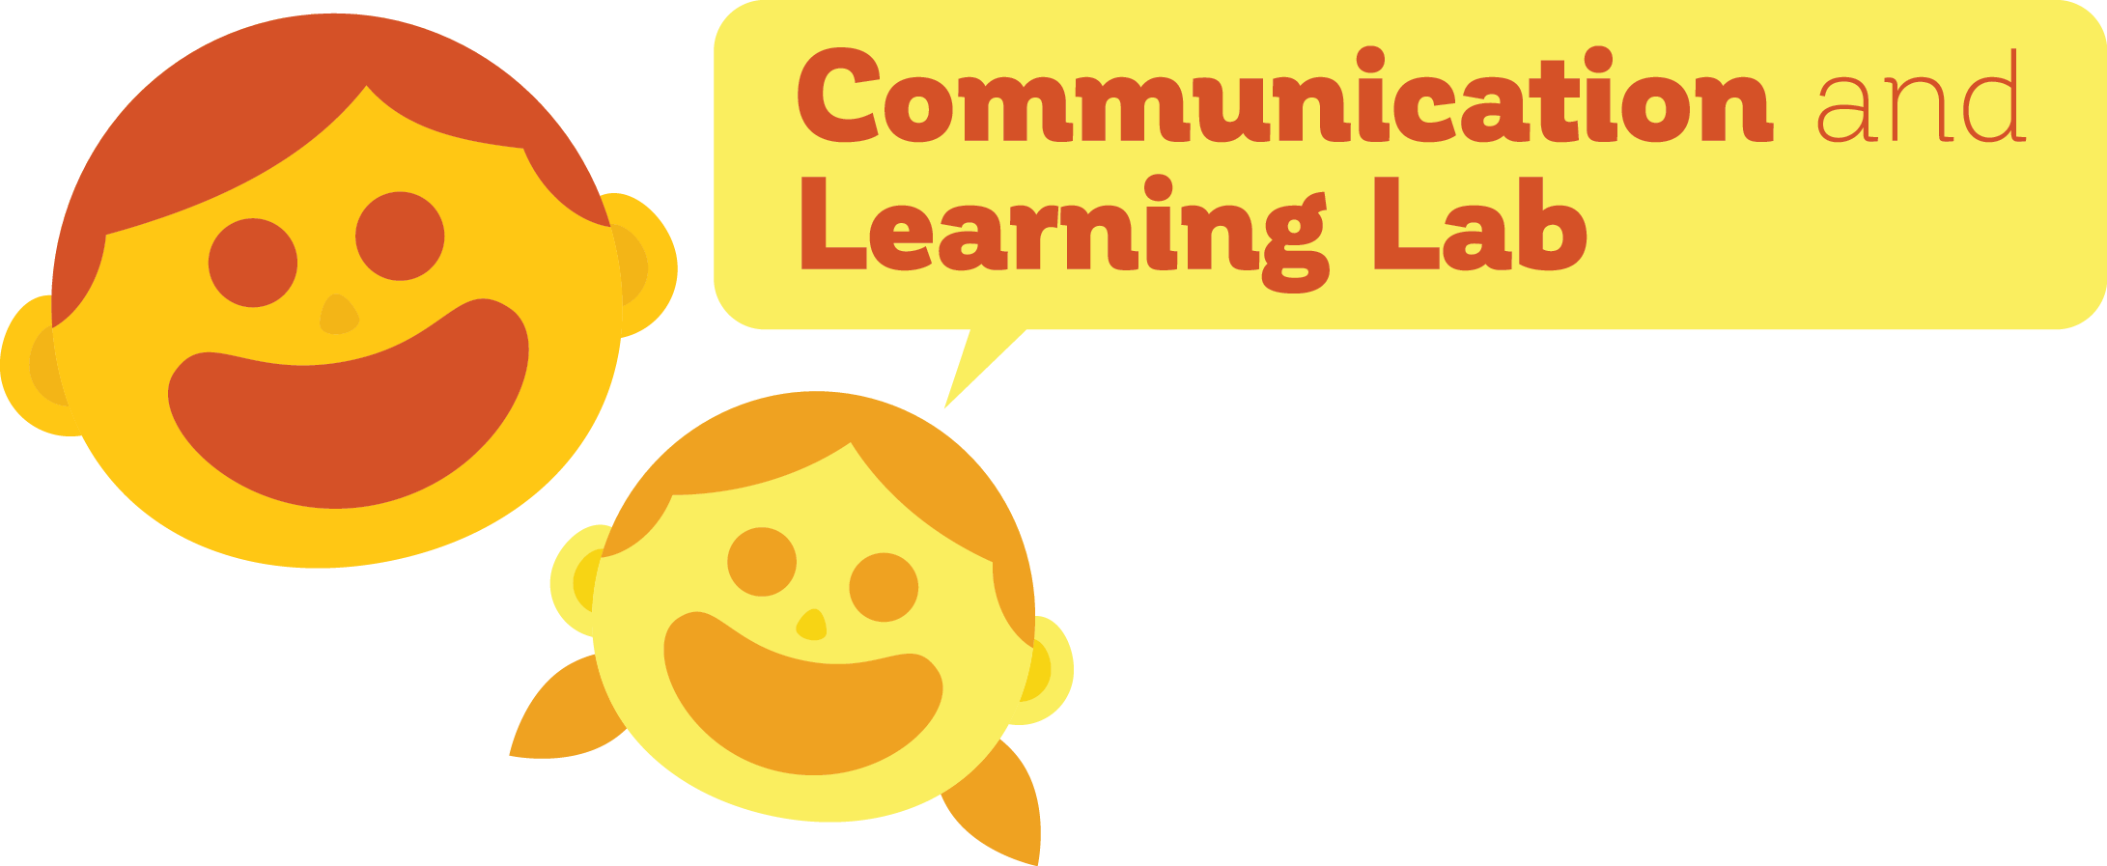
Interlocutors preserve complexity in language
Madeline Meyers
PI: Dan Yurovsky, Ph.D.
University of Chicago

Slide 2
Languages change
Old English (450 – 1150 BCE)
Modern English
heorte
heart
brodor
brother
thou
Brainerd (1989)
Notes:
Also, the extent to which these have been seen as taboos in writing has decreased since the late 18th century, and has decreased now; Language EVOLUTION change over time; may is not really used anymore; prescriptivism doesn’t make any sense teaching, but actually we lose these things; fridge versus refrigerator? Personal computer? Just putting up old English versus now (thou is gone?)

Slide 3
Why do languages evolve?
Languages need to be effective for communication
Languages need to be easily learnable by new speakers

Slide 4
Language-learning pressures in context
Learnability
Communicability
Baba!
Baba!
Notes:
Sheep & bottle were not learnable for this child; so child makes simplifying errors
Children may be particularly biased for simplicity pressure
-talk about why baba is a problem, not a super compelling issue
-use uniqueness vs. communicability [maybe don’t even talk about descriptiveness]

Slide 5
Children might respond differently to these pressures
Children:
Have less experience with language
Have different cognitive systems
Notes:
Lower working memories; also speak to weird people
TOOK OUT PICTURES, MAYBE PUT SOME IN HERE?

Slide 6
…Perhaps perpetuating their errors
This is a baba!
Baba!
Baba!
Notes:
MAKE SLIDE THAT SHOWS KIDDOS COULD PERPETUATE BABA LABEL, BUT THAT’S NOT ACTUALLY WHAT HAPPENS BECAUSE PARENTS INTERVENE AND PROVIDE FEEDBACK; PARENTS LET THEIR CHILDREN BE ERRORFUL FOR A WHILE BUT EVENTUALLY MAKE SURE THE KIDDOS GET IT RIGHT
-CUT THIS SLIDE

Slide 7
But…
Children have unique conversational partners
Notes:
This is what prior work has been doing ; add in corrections and talk about dynamic

Slide 8
These interlocutors provide key feedback
This feedback may protect against oversimplification in language
This is a bottle
This is a bottle
Baba!
Bottle!
No, bottle
Notes:
This is what prior work has been doing ; add in corrections and talk about dynamic

Slide 9

Using iterated learning to study evolution
Randomly-generated language
Generation 1
Generation 2
Resultant language
Generation 3
Kirby et al. (2008)
Notes:
How do we study the effects of these pressures on language in the lab??

Slide 10
Using iterated learning to study evolution
Randomly-generated language
Generation 1
Generation 2
Resultant language
Generation 3
Notes:
How do we study the effects of these pressures on language in the lab??

Slide 11
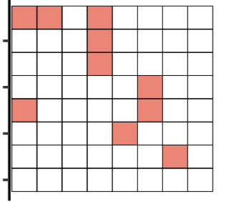
Experiment 1 paradigm
Kempe et al. (2015)
Notes:
Introduce dot patterns earlier

Slide 12
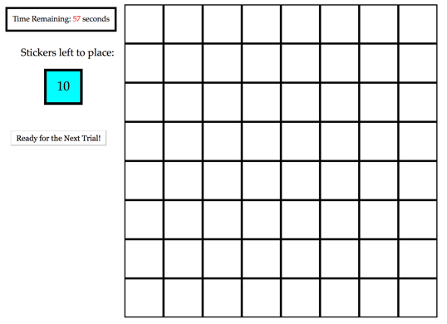
Experiment 1 paradigm

Slide 13
Experiment 1: replicating previous iterated learning work
120 adults on Amazon Mechanical Turk
20 separate chains of 6 generations
Measured
Percent Accuracy
Complexity

Slide 14
Accuracy increases over generations
Meyers, Yurovsky (under review)

Slide 15
Complexity decreases over generations
Notes:
Put grids directly on this plot
Directly replicates Kempe findings

Slide 16
Experiment 2: Replication/extension of experiment 1
480 adults on Amazon Mechanical Turk
40 separate chains of 12 generations
Measured
Percent Accuracy
Complexity

Slide 17
Accuracy increases over generations

Slide 18
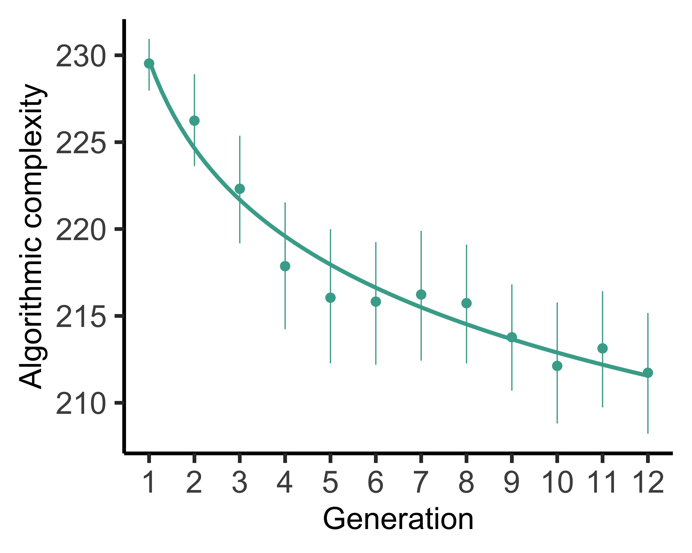
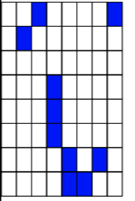
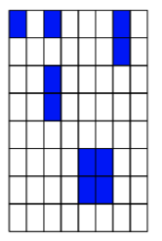
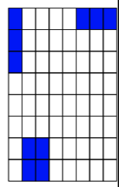
Complexity decreases over generations
Notes:
Put grids directly on this plot
Directly replicates Kempe findings

Slide 19
Experiment 3 paradigm
Randomly-generated language
Generation 1
Generation 2
Resultant language
Generation 3
Notes:
How do we study the effects of these pressures on language in the lab??

Slide 20
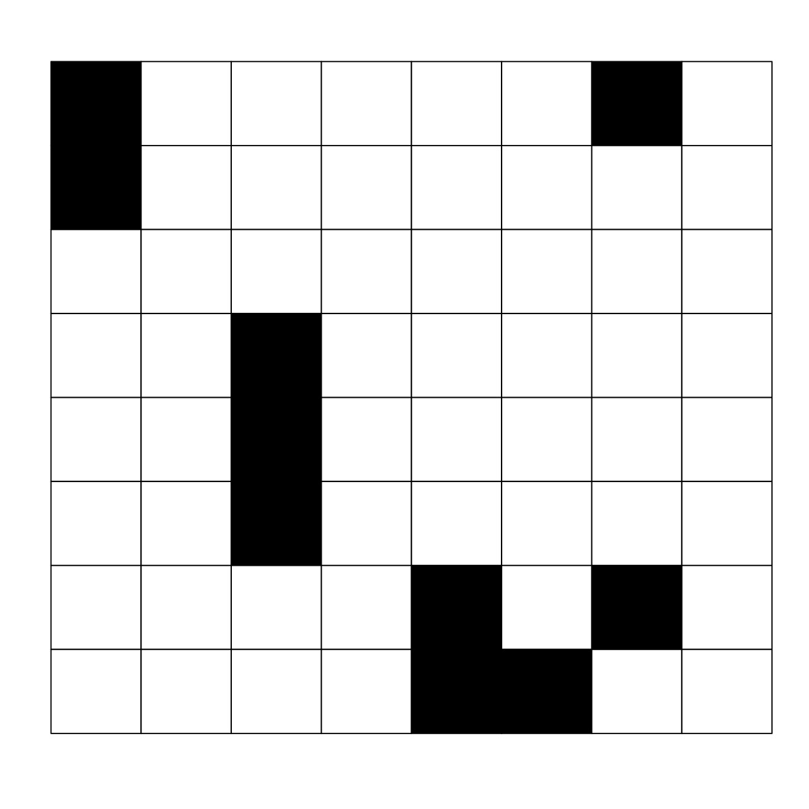
Experiment 3 paradigm
1 ) Learner

Slide 21
Experiment 3 paradigm
1 ) Learner
“your job is to re-create patterns to match a target”

Slide 22
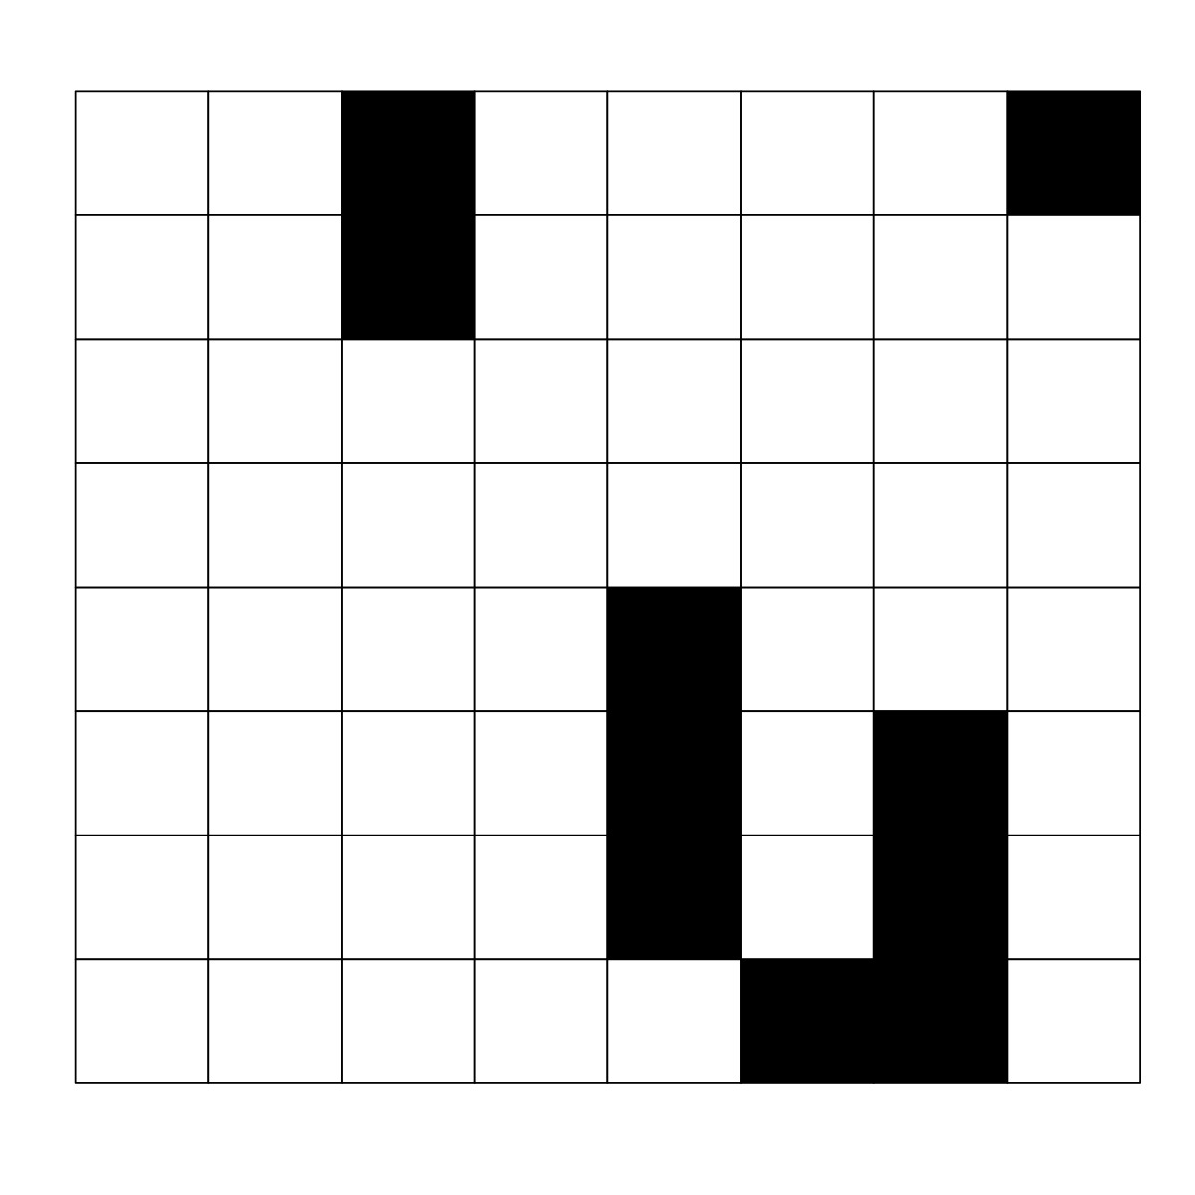
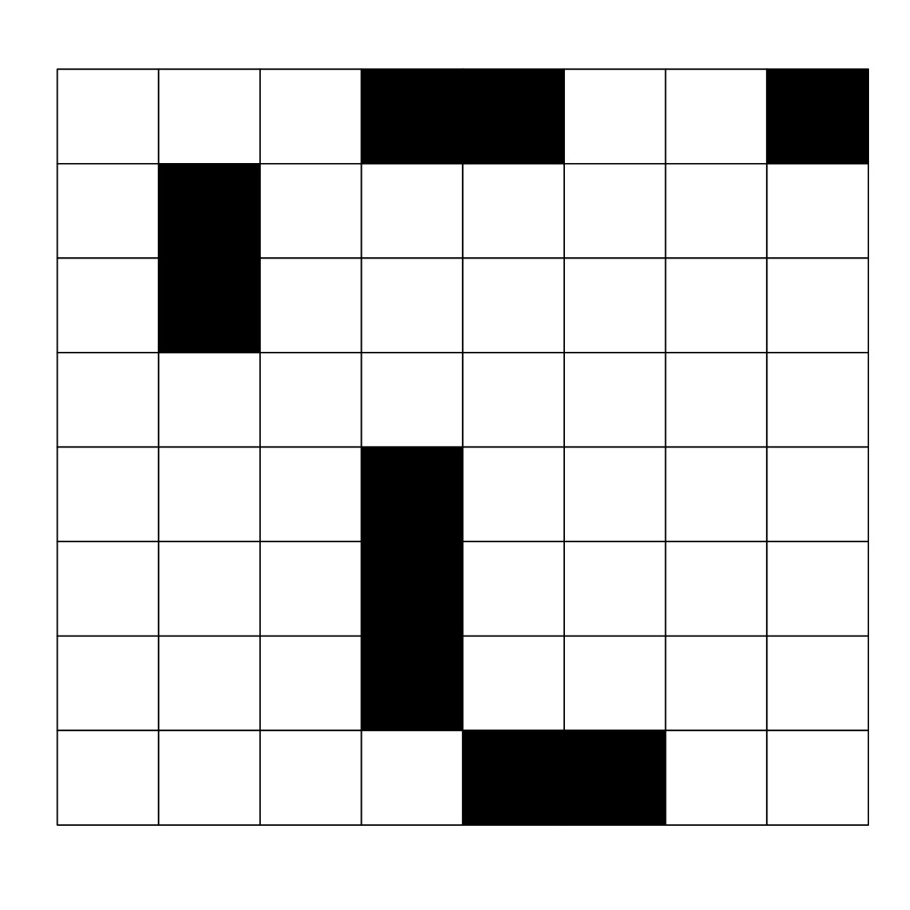
Experiment 3 paradigm
1 ) Learner

Slide 23
Experiment 3 paradigm
2) Fixer

Slide 24
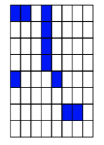
Experiment 3 paradigm
2) Fixer
“your job is to correct errors on the grid patterns to match the target”
Notes:
Explain more how this is an easier task [change-detection versus spontaneous generation task]

Slide 25
Experiment 3 paradigm
2) Fixer

Slide 26
Experiment 3: ADULT-ADULT DYAD
960 adults on Amazon Mechanical Turk
480 Learners, 480 Fixers
40 separate chains of 12 generations

Slide 27
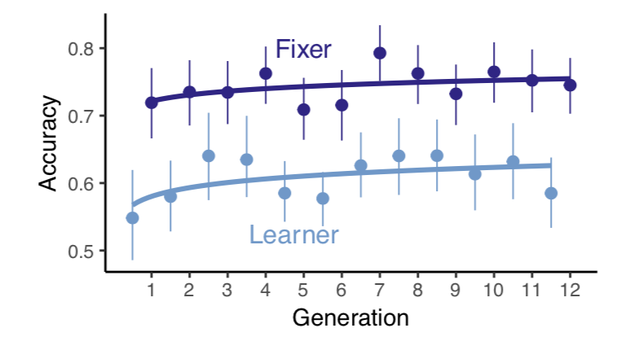
DYAD achieves consistent levels of accuracy
Notes:
Make sure that justification for fixer-parent

Slide 28
While Editors Reintroduce complexity
Notes:
Learner is not red change color ; fix axes ; think about how to talk about passing on fixer’s language
-add in seesaw lines

Slide 29
Editors help retain a higher level of complexity
Notes:
Feedback on how to describe the fixer passing on language
-put in broken line for y-axis scale

Slide 30
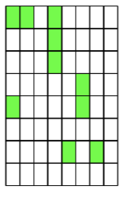
Preliminary conclusions
Complexity is lost in transmission
This complexity is not lost forever
The presence of an editor helps retain more complexity than an individual learner alone
Stability was higher & was reached faster
Languages change in response to their learners and speakers
Our biases matter
Our conversational partners matter
Notes:
-bring in more learnability/communicability (or skip maybe?)

Slide 31

Future directions
Wait, but you didn’t test real kids?
Data collection is ongoing!
Notes:
FRONTLOAD; may recapitulate and justifies adults

Slide 32
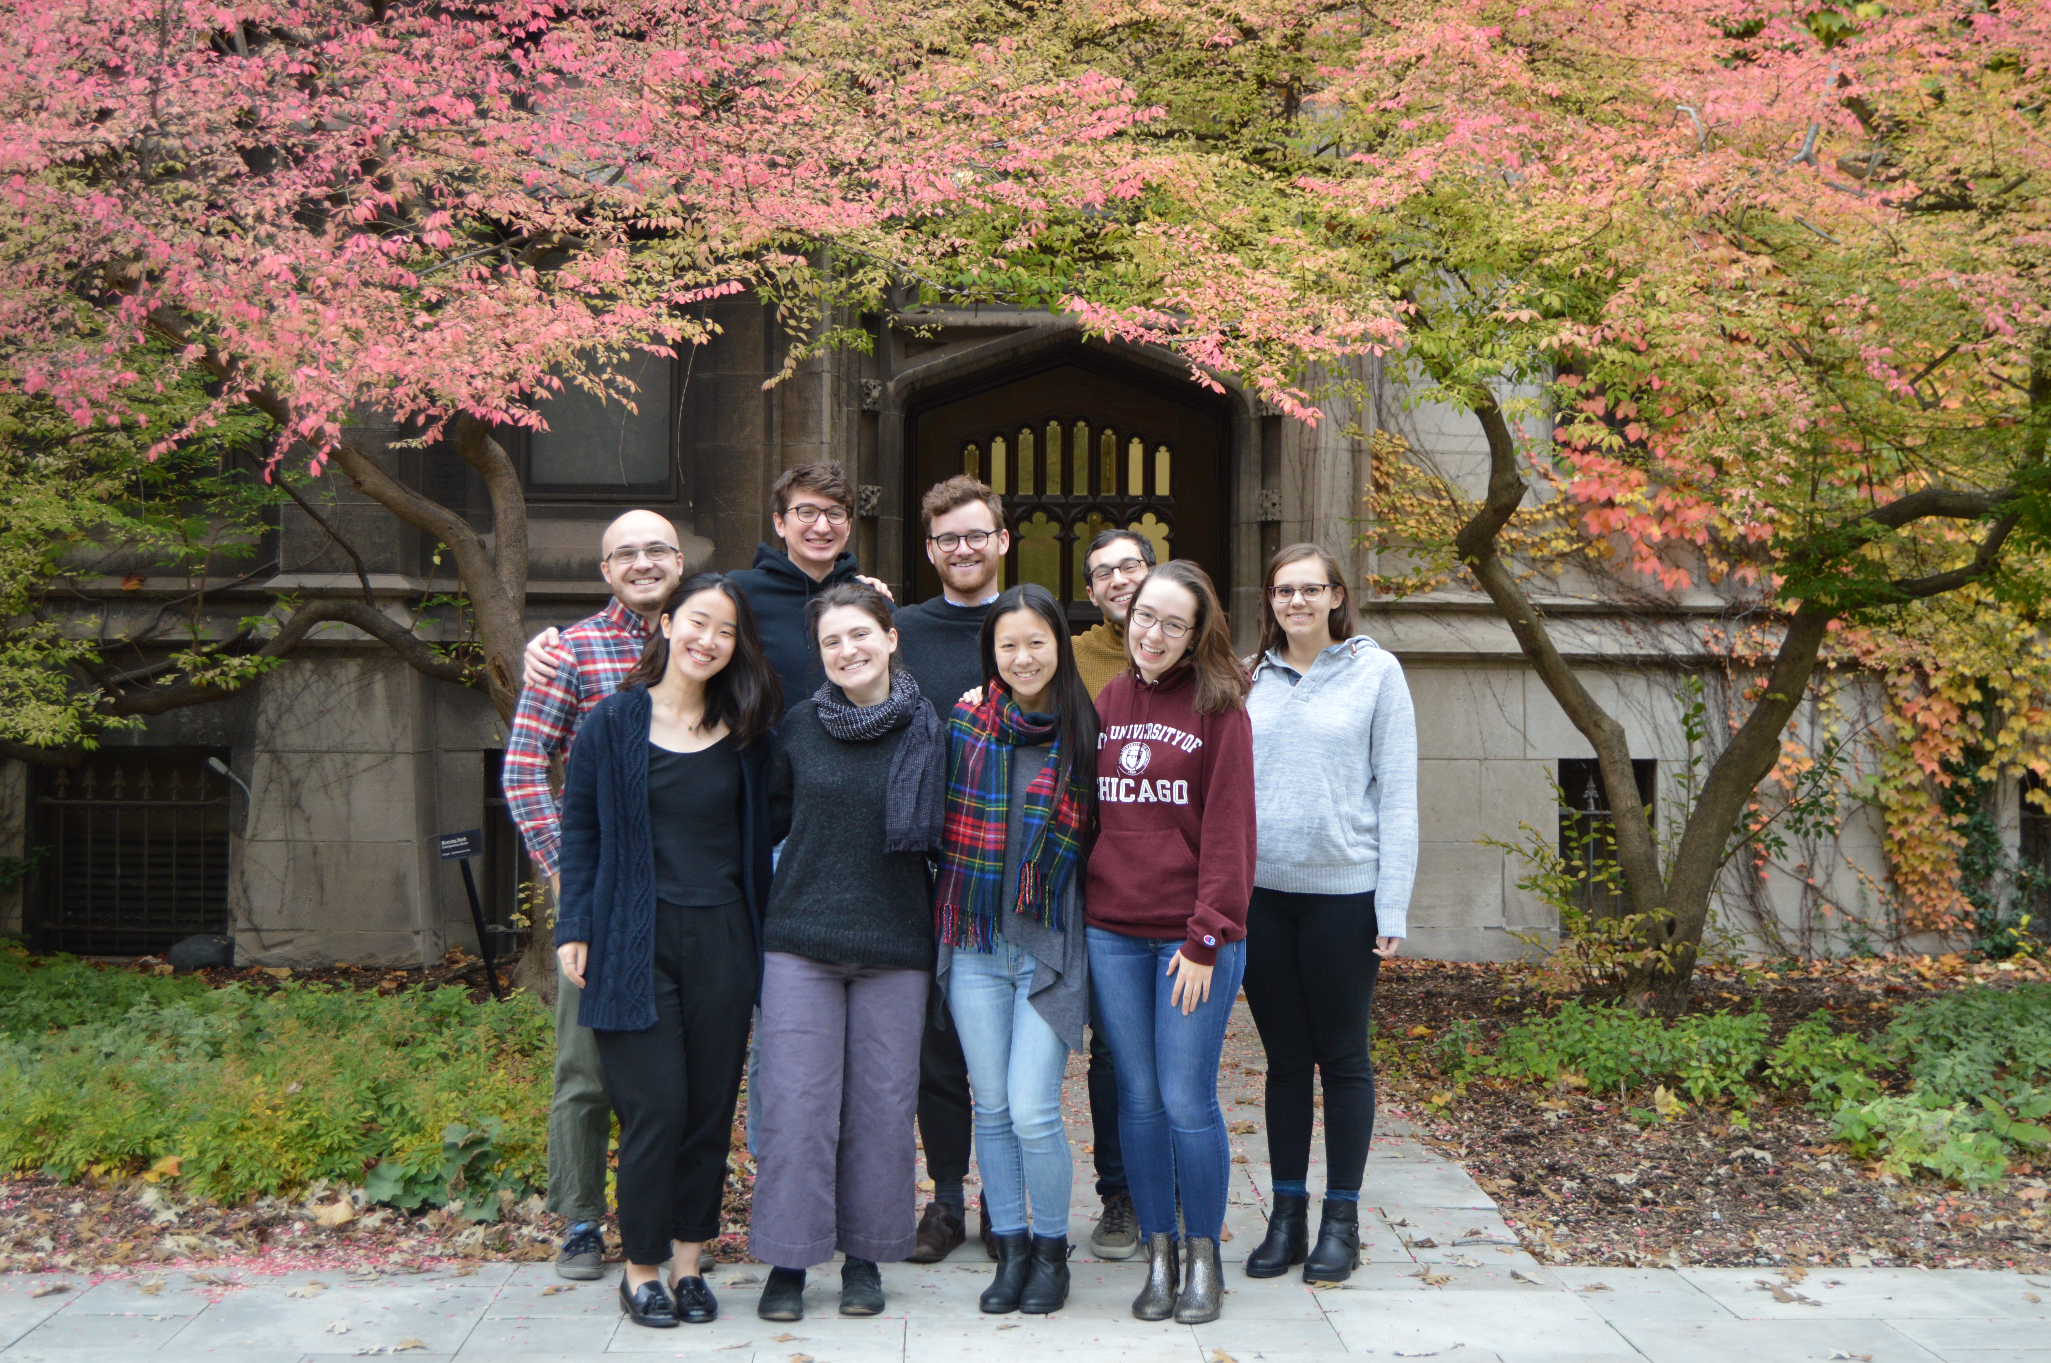


Thank you!

Slide 33
Algorithmic complexity measure
“fill in two cells diagonal in the top, one on the right hand corner, three that are third from the left, make an angular shape and add a diagonal.”
“fill in every other cell”
Zenil et al. (2015)
Notes:
Keep examples but maybe take out text; simpler measures of complexity and compare to other things

Slide 34
Algorithmic complexity measure ctd.
Kolmogorov-Chaitin Complexity (based on Coding Theorem Method)
Length of shortest program that outputs a string to describe pattern on a Universal Turing machine
Calculate for 4x4 patterns
Zenil et al. (2015)
Notes:
Keep examples but maybe take out text; simpler measures of complexity and compare to other things

Slide 35
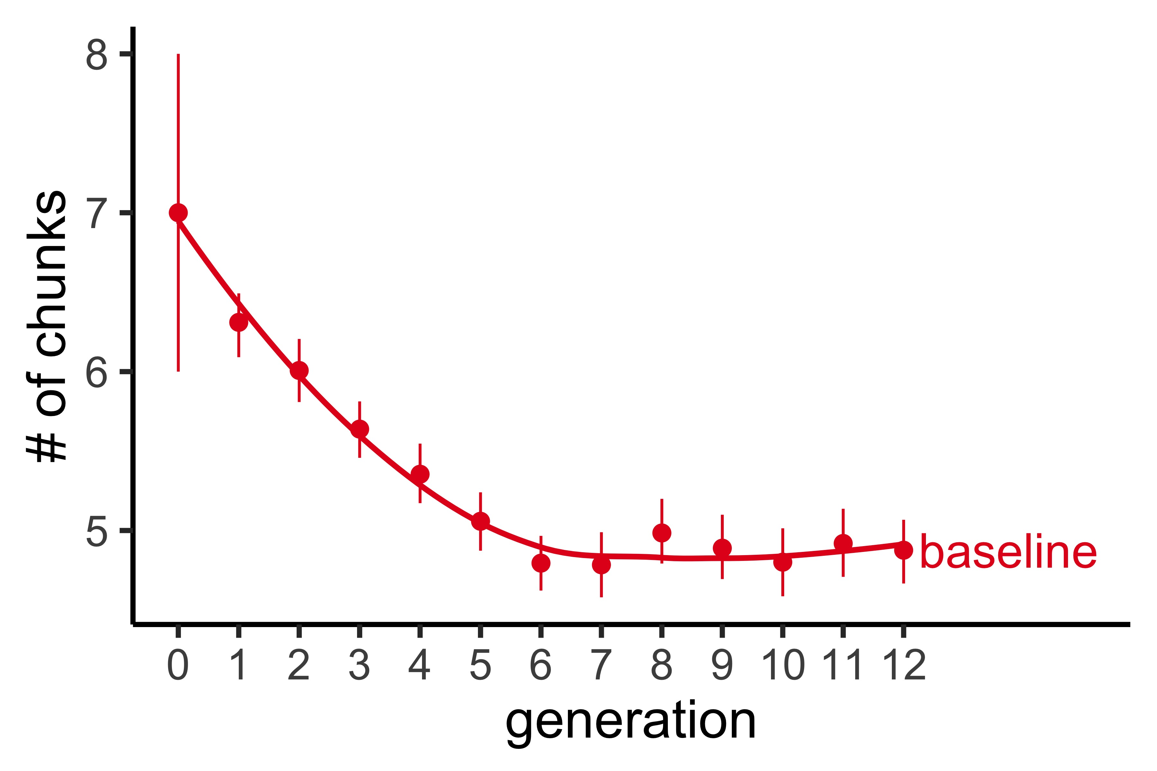
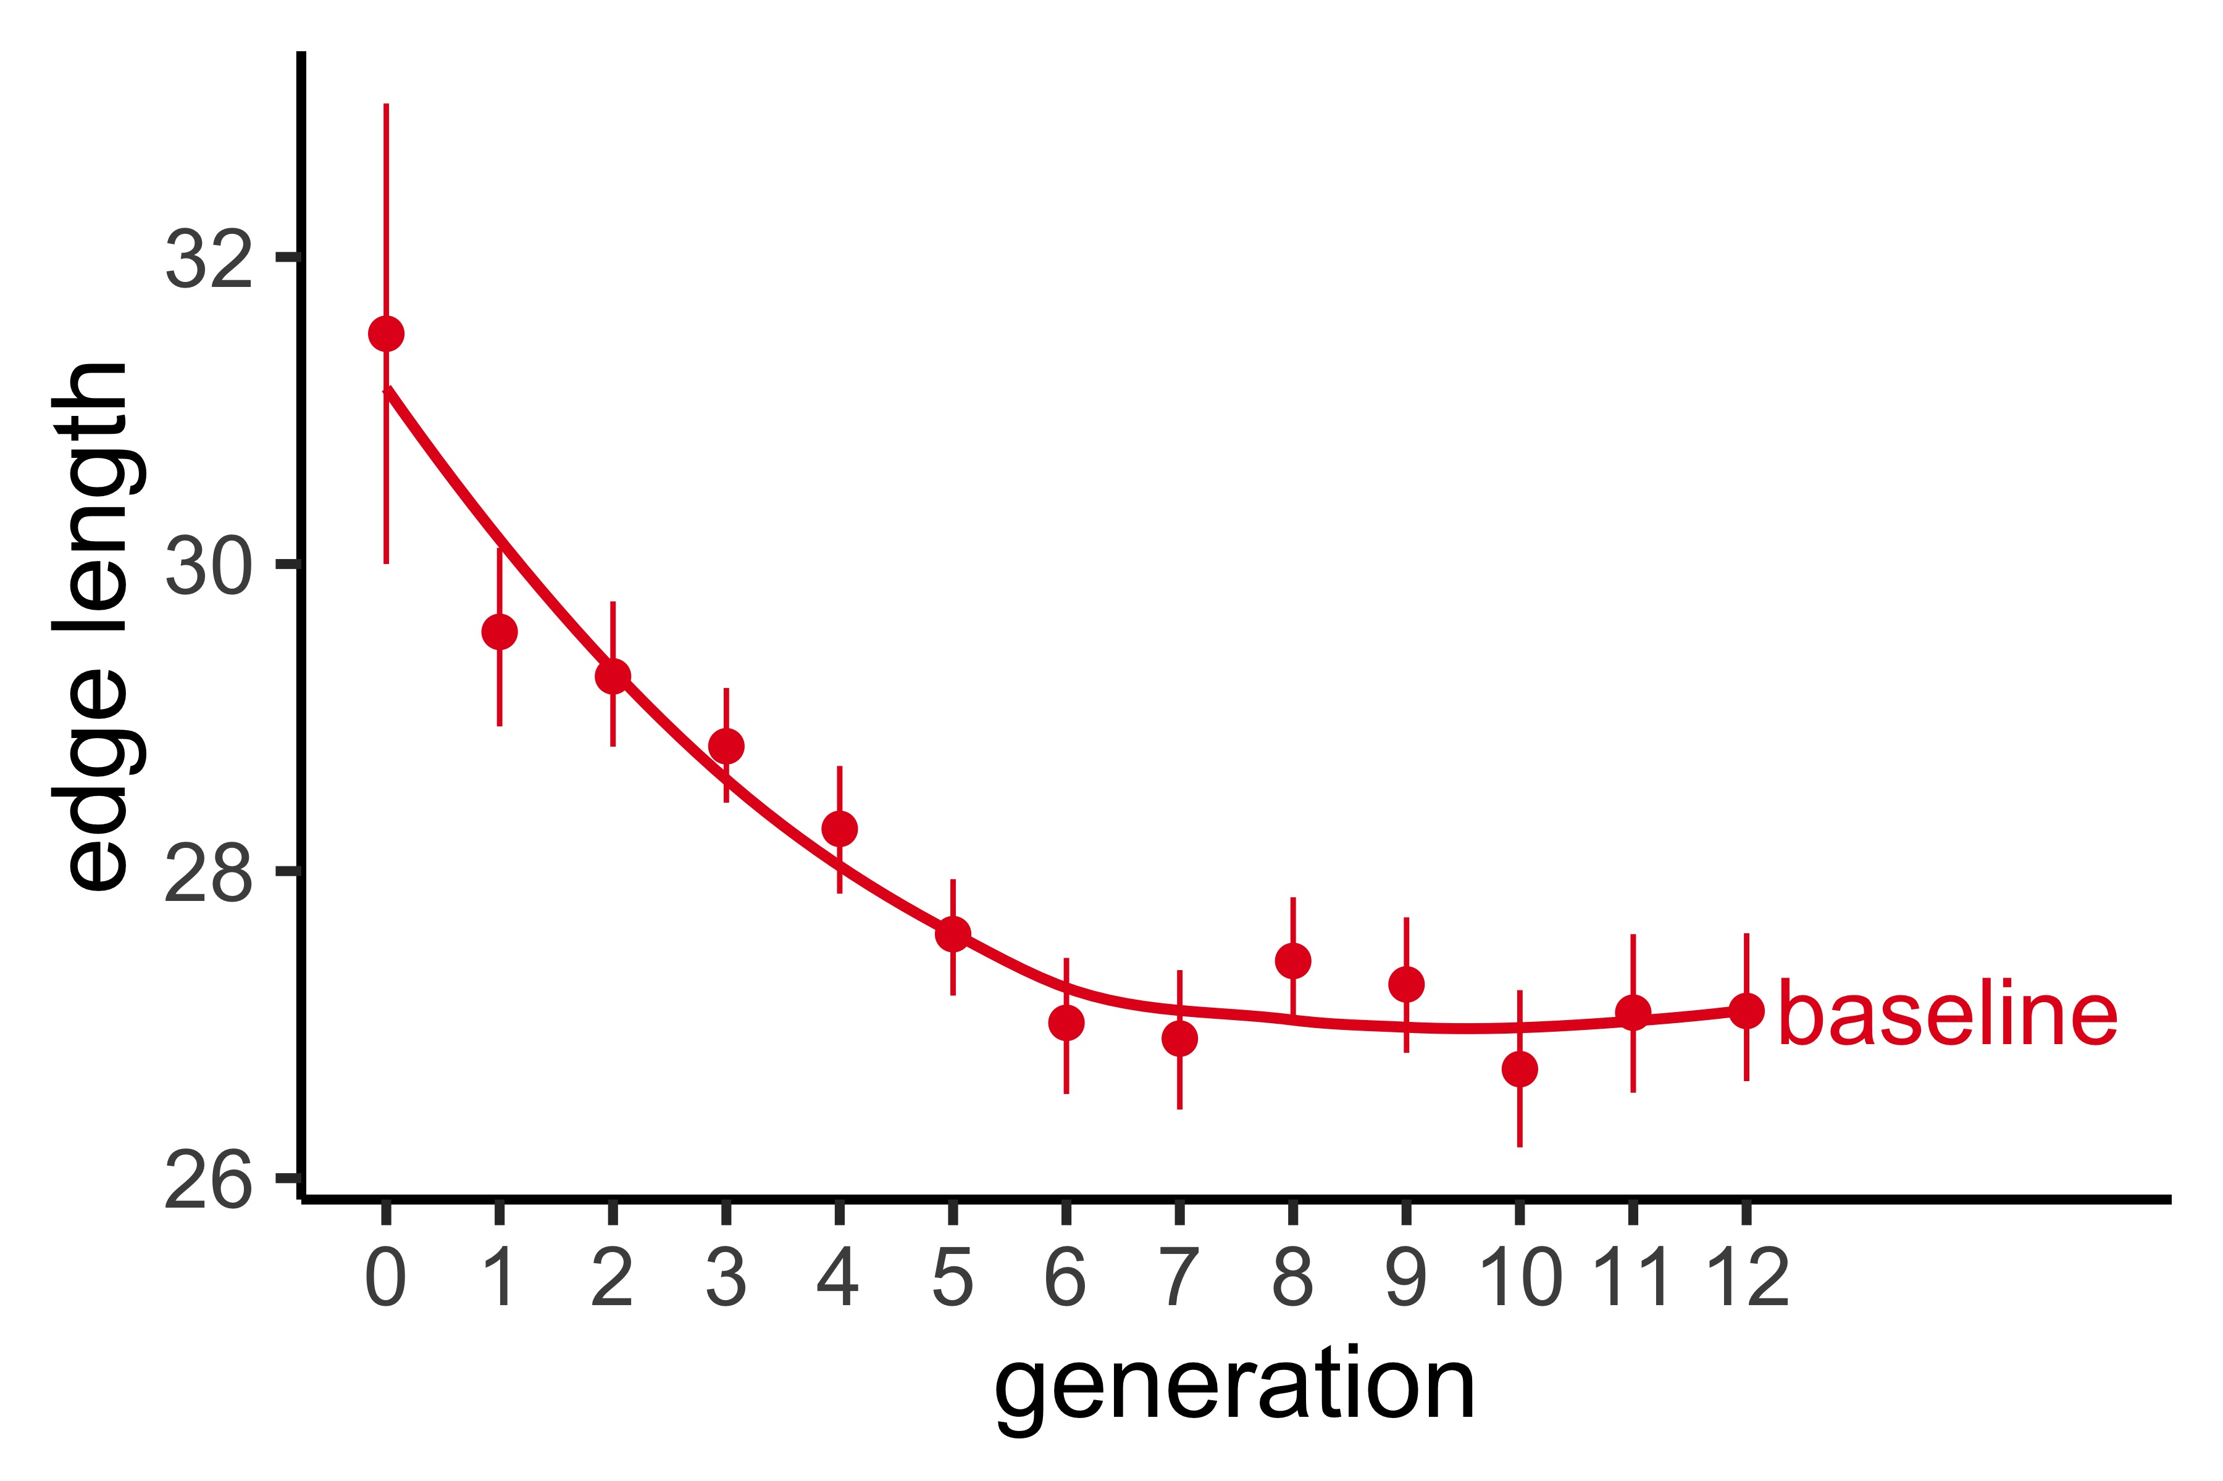
Additional complexity plots

Slide 36
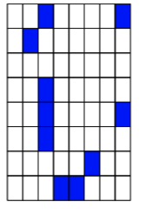
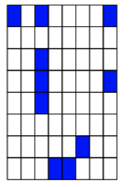
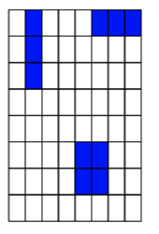
Experiment 1 results
Initial
Generation1
Generation 2
Generation 4
Complexity: 231
Complexity: 235
Complexity: 243
Complexity: 211
Generation 5
Generation 9
Generation 12
Complexity: 229
Complexity:
Complexity:

